Slide 1
Programming II
Faculty of Mathematics and Physics
Charles University in Prague
19th May 2016
C# Made Easy!
Workshop 12 – Graph Algorithms

Slide 2
Workshop 12 Outline
Test
Workshop Finals
Graph Algorithms
Homework

Slide 3
Questionnaire 1 No Test
Find the questionnaire here (no-ads):
https://goo.gl/JRGhFL
0 vs. O vs. o, i vs. l vs. 1
Permanent link:
https://docs.google.com/forms/d/1Yw_BBLhuB-_4-sEEU0PiajO9ijacv99vmaMX-ovmzUM/viewform
Time:
As much as you need

Slide 4
Workshop 12 Finals
You will code the Final Workshop Test next week during Workshop 13, 26.5.2016
You should revisit:
Recursion
Graph representation
DFS, BFS
Minimax for games
In order to feel like…

Slide 5
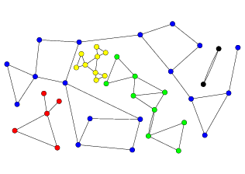
Graph Algorithms 1. Components

Slide 6
Graph Algorithms 1. Components
Algorithm?
Use BFS or DFS to label nodes
of single component, always
start from unlabelled node.
Repeat it as long as there are any unlabelled nodes in the graph.
Complexity?

Slide 7
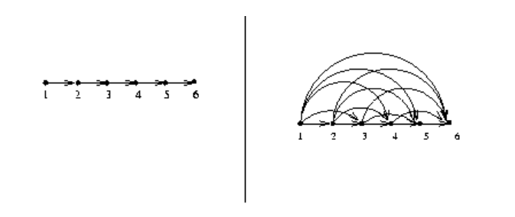
Graph Algorithms 2. Graph transitive closure

Slide 8
Graph Algorithms 2. Graph transitive closure
Algorithm?
For every Vertex:
Launch DFS or BFS and introduce new edges when new vertex is reached.
Complexity?

Slide 9
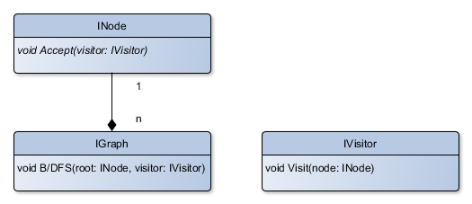
Graph Algorithms 1+2 Implementation?
We have two graph algorithms using B/DFS … can we somehow split the implementation between “bare” B/DFS and “algorithm internals” ?

Slide 10
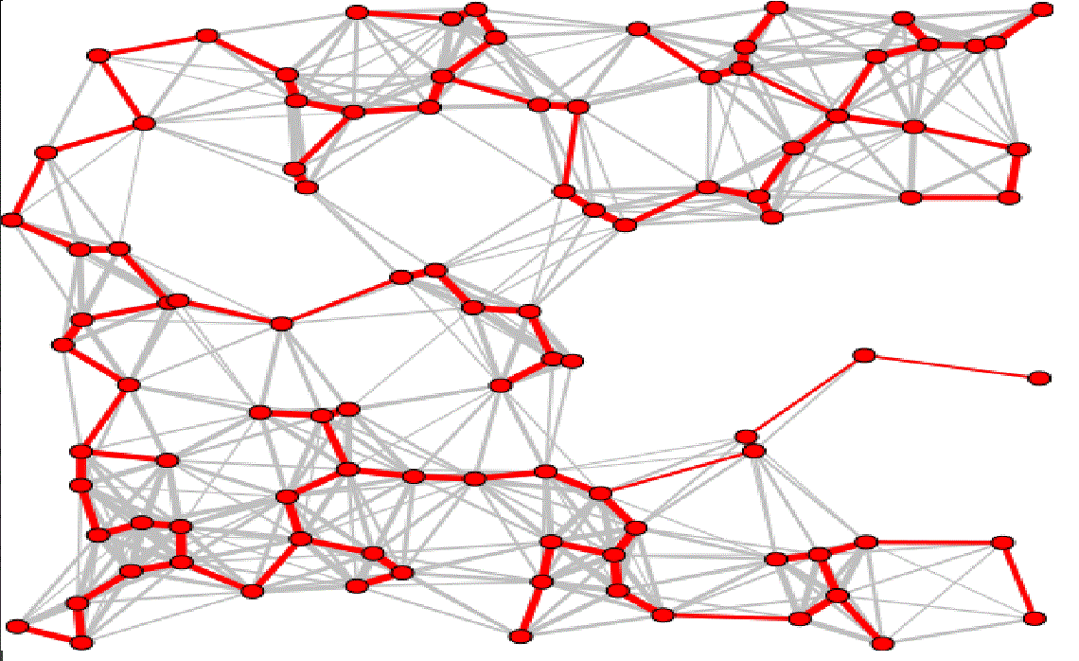
Graph Algorithms 3. Minimum spanning tree

Slide 11
Graph Algorithms 3. Minimum spanning tree
Algorithm?
Kruskal’s hungry algorithm:
For every component:
Order edges according to their value
For each edge … add it to the result if it does not form the circle with already included edges
Complexity?

Slide 12
Assignment 12.1 Graph algorithms
GRAPH INPUT:
<int> ‘\n’ [ <node> ‘ ’ <link> ‘ ’ <node> ‘\n’ ]+
<node> : [a-zA-Z]+
<link>: [ <non-oriented-link> | <oriented-link> ]
<non-oriented-link>: ‘<--(’ <int> ‘)-->’
<oriented-link>: ‘--(’ <int> ‘)-->’

Slide 13
Assignment 12.1 Graph algorithms
Implement a GUI application that provides visualization of the graph via spring-algorithm
Provide buttons for computing:
Component labeling
5 points
Graph transitive closure of all components
5 points
[BONUS] Minimum spanning tree of all components
5 bonus points
10 points + 5 bonus points
Bonus points deadline: 31.5.2016 23:59
Notes:
Delete this slide …

Slide 14
Assignment 12.2 Get ready…
Have you played this during last week?
This is going to be HUGE ☺

Slide 15
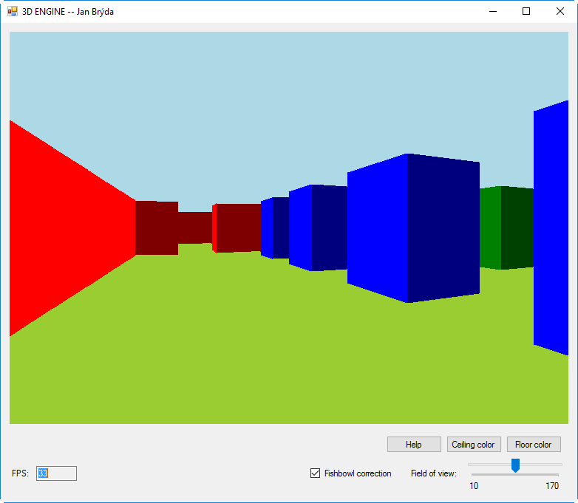
Assignment 12.2 3D Engine!
Have you played this during last week?

Slide 16
Assignment 12.2 3D Engine!
Have you played this during last week?
Don’t get scared!
Can be written in about 300 lines!
http://goo.gl/QbcSt0
Permalink:
http://www.playfuljs.com/a-first-person-engine-in-265-lines/
Input file:
NxN
<maze>
Example
10x6
##########
#........#
####.###.#
#..#.#.#.#
#........#
##########
30+15 bonus points

Slide 17
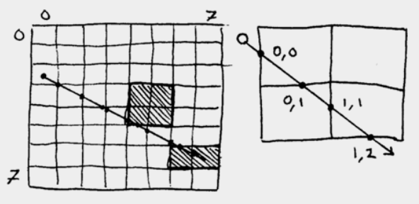
Assignment 12.2 3D Engine!
On Event (button clicked / resize):
//DrawSky() // optional
//DrawFloor() // optional
DrawWalls()
Drawing walls will need
double Raycast(x, y, angle, max)
[x;y] where we’re casting the ray from
angle (horizontal) we’re throwing the ray in
max – limiting raycasting length
Returns distance to the wall (or -1 if the wall not hit in “maxDistance”)
Notes:
Delete this slide …

Slide 18
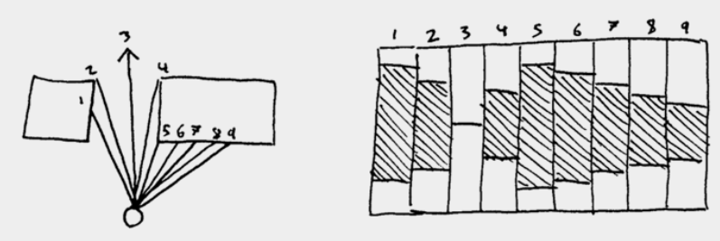
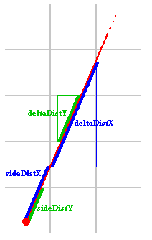
Assignment 12.2 3D Engine!
http://lodev.org/cgtutor/raycasting.html
Notes:
Delete this slide …

Slide 19
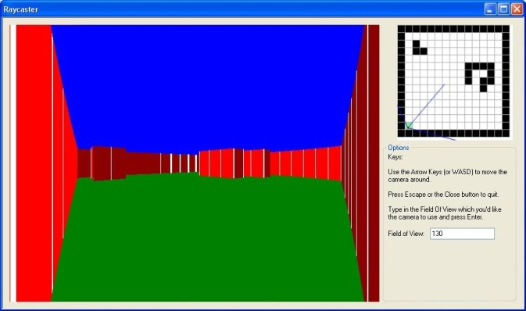
Assignment 12.2 3D Engine
Different colors for different wall sides
Redraw on screen resize
Provide buttons for Movement (turn left/right, move forward/backward)
Provide color picker for walls
Provide a way for changing FOV
Provide a way for disabling “fish-eye” correction
30 points + 15 bonus points
Bonus section
Provide (continuous) movement through keyboard (WSAD)
5 bonus points
Do not cross walls
5 bonus points
Draw sky + floor + provide color pickers for them
5 bonus points
Notes:
Delete this slide …

Slide 20
Assignment 12.1 + 12.2 Send me an email
Email: jakub.gemrot@gmail.com
Subject: Programming II – 2016 – Assignment 12.1 / 12.2
Zip up the whole solution and send it
You WILL NOT find these assignments in CoDex!
Deadline:
30.9.2016 23:59
Points:
Graph algorithms: 10 + 5
3D Engine: 30 + 15

Slide 21
Questions? I sense a soul in search of answers…
In case of doubts about the assignment or some other problems don’t hesitate to contact me!
Jakub Gemrot
gemrot@gamedev.cuni.cz

