Slide 1
Programming II
Faculty of Mathematics and Physics
Charles University in Prague
5th May 2016
C# Made Easy!
Workshop 10 – XP

Slide 2
Workshop 10 Outline
Test
Extreme Programming
Homework

Slide 3
Test 10 Test
Find the test here (no-ads):
https://goo.gl/xJVsRH
Permanent link:
https://docs.google.com/forms/d/177cyBCR07Zw1uLH2YNKmsH64ARGmrXt1Ttg7fepyVlU/viewform
Time for the test:
5 min

Slide 4
Extreme Programming Software Development Methodology

Slide 5
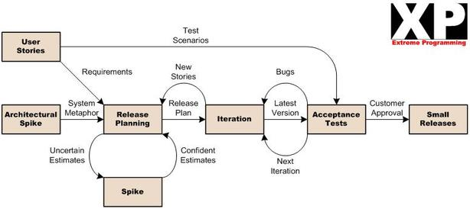
Extreme Programming Software Development Methodology
What the customer wants.
What are we going to do next?
1-3 weeks
How are we supposed to implement it
We’re working like mad!
Does it meet customer’s expectations?
Let the customer to use it.
Clearing implementation doubts

Slide 6
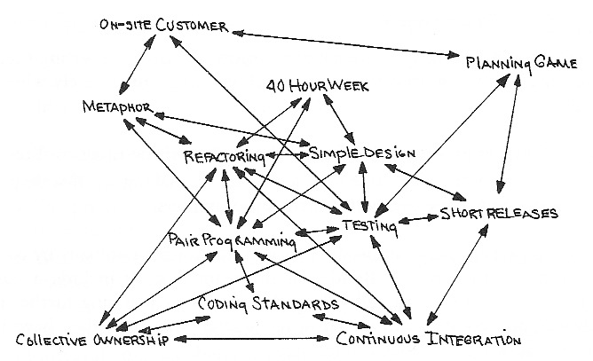
Extreme Programming Software Development Methodology
Today, a programmer needs to be able to do all kinds of “jobs”.
Notes:
The problem is, that everything is intertwined in programming and you can easily be delayed by others in the team…

Slide 7
Extreme Programming Software Development Methodology
Important for teams!
Which we sort-of lack here…
Alas, we’re going to investigate the following:
The Code is The Documentation
=> The code should speak for itself
Pair Programming
=> Helps you to focus your thoughts and write bug-less code
Notes:
Delete this slide …

Slide 8
Extreme Programming The Code is The Documentation
Apart from obvious naming conventions…
Name your temporary variables well
public Node Add(int num) {
Node n = new Node(num);
…
return n;
}
public Node Add(int num) {
Node result = new Node(num);
…
return result;
}
Notes:
Delete this slide …

Slide 9
Extreme Programming The Code is The Documentation
Apart from obvious naming conventions…
Avoid obvious I, J, K variable names in for-loops
for (int i = 0;
i < lines.Count();
++i) {
…
}
for (int lineIndex = 0;
lineIndex < lines.Count();
++ lineIndex ) {
…
}
Notes:
Delete this slide …

Slide 10
Extreme Programming The Code is The Documentation
Apart from obvious naming conventions…
Document the idea behind the code, not what the code is doing
Document contracts
// Returns ROOT node
public NODE GetRoot();
// Returns ROOT of the tree that is guaranteed to remain the same throughout the life of the TREE object
public NODE GetRoot()
Notes:
Delete this slide …

Slide 11
Extreme Programming The Code is The Documentation
WHY WE NEED DOCUMENTATION?
The code is the imperfect translation into a programming language of the programmer’s imperfect understanding about what the program should do.
If unsure how to code your idea, write down your idea/objective in plain language (e.g. as a comment to a class, a method or code block) and leave it there after you code it
And after you code your idea/objective, review your comment if it still holds!
WHY WE SOMETIMES HATE DOCUMENTATION?
The documentation is a set of hypotheses to be tested and not a set of axioms to be trusted. And it ages…
You will never know whether the method/class/sub-system behaves as documented / expected until you try == first-hand experience is the best
If you are unsure about the technology, do not go on wild implementing features in real-project, play with the technology elsewhere, safely
(~ sort of SPIKEs in XP terminology)
Notes:
Delete this slide …

Slide 12
Extreme Programming Pair Programming
Two roles: Driver and Navigator
Driver
Writes the code
Navigator (preferably in this order)
Reviews each line of the code
Typos
Coding standards
Bugs!!!
Thinks about “next step”
Thinks about the overall architecture
Let’s form pairs!
Notes:
Delete this slide …

Slide 13
Extreme Programming Task – Visualization of Binary Search Tree
Download the template: http://goo.gl/WkLMWR
Provide a way to visualize a binary search tree
Come up with a metaphore for the visualization
Binary tree-like layout
Node as a circle with a number in its center
Edges between parent-child
Repaint on screen resize
Always fit into “the entire window”
And be warned… the customer will likely need to change this layouting in the future!
=> Try to separate “drawing commands” from the “layouting algorithm”
Notes:
Metaphore== how would you desribe it to your grandmother

Slide 14
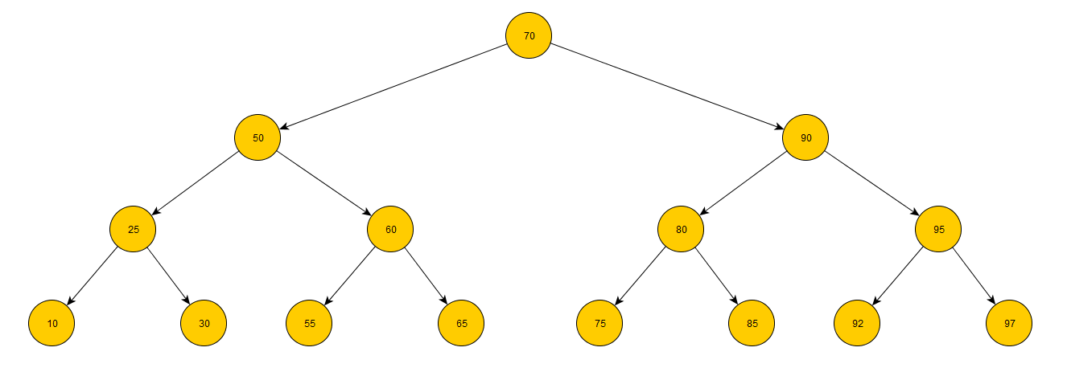
Extreme Programming The Task – Visualization of Binary Search Tree
Fixed Layout
Tree Height / Layer-depth determines the layout
Notes:
Delete this slide …

Slide 15
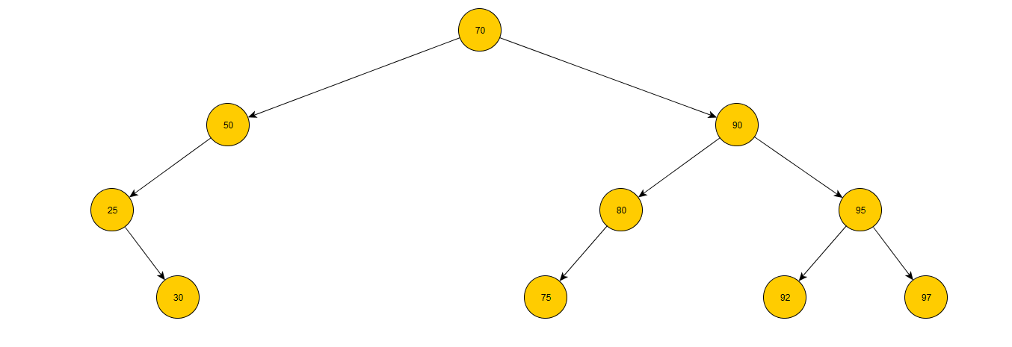
Extreme Programming The Task – Visualization of Binary Search Tree
Fixed Layout
Tree Height / Layer-depth determines the layout
Even if the tree is not full, the positions of respective nodes do not changes
Notes:
Delete this slide …

Slide 16
Extreme Programming The Task – Visualization of Binary Search Tree
GOOD LUCK!
Decide on Driver & Navigator
Analyze existing code base together
Analyze the task together and come up with solution for the layouting algorithm
Design an architecture for algorithm implementation
Beware, the layouting algorithm will likely be changed in the future
But do not over-engineer this!
Code it!
Notes:
Delete this slide …

Slide 17
Extreme Programming Homework – Flexible Layout for Binary Tree
Continue the work on your code alone and:
Provide a way to add “multiple numbers comma separated” at once (new text box, new button)
Implement flexible layout for the tree
Notes:
Delete this slide …

Slide 18
Extreme Programming Homework – Flexible Layout for Binary Tree
Fixed Layout
Notes:
Delete this slide …

Slide 19
Extreme Programming Homework – Flexible Layout for Binary Tree
Fixed Layout
Tree Height / Layer-depth determines the layout
Notes:
Delete this slide …

Slide 20
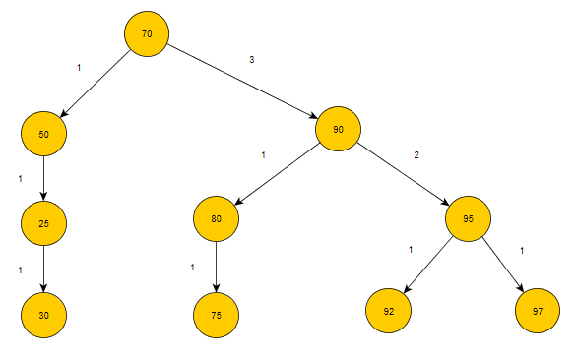
Extreme Programming Homework – Flexible Layout for Binary Tree
Flexible Layout
Sub-tree width determines the layout
Notes:
Delete this slide …

Slide 21
Assignment 10 Send me an email
Email: jakub.gemrot@gmail.com
Subject: Programming II – 2016 – Assignment 10
Body: state who you have coded the assignment with
Zip up the whole solution and send it
You WILL NOT find the assignment in CoDex!
Deadline:
12.5.2015 23:59
Points: 10 + 5 (meeting the deadline)

Slide 22
Questions? I sense a soul in search of answers…
In case of doubts about the assignment or some other problems don’t hesitate to contact me!
Jakub Gemrot
gemrot@gamedev.cuni.cz

