Slide 1
Programming II
Faculty of Mathematics and Physics
Charles University in Prague
24th March 2016
C# Made Easy!
Workshop 4 – The Snake and OOP

Slide 2
Workshop 4 Outline
(No) Test
The Snake - Reloded

Slide 3
(No) Test 04 Quick Warm up!
Find the test here (no-ads):
https://goo.gl/zozqz7
O vs. 0, i vs. l vs. 1
Permanent link:
https://docs.google.com/forms/d/1cl8d3LcijqX8DoIjX8wiHAh2RpRDPRq_KW-ND5-SKyc/viewform
Time for no-test:
5 min

Slide 4
Assignment (3+)4 Create “The Snake” aka “The Worm” game
Console application (text-based game)
Snake is controlled either by WSAD, or arrows, or 8246 numbers
You have to display “snake’s length” and “time elapsed” somewhere at “bottom status line”
Escape key terminates the game
Implement tiles: Empty, Wall, Food, Posion, Wine, “Snake”
Snake movement speed should be increasing every N food eaten (regardless their calories)
Provide solution that can easily change
Map dimensions
Ask me on how big map I want to play (max 80 x 40)
Food effects
Adding new food should be as easy as creating and „registering“ a new Food object
Both POISON and WALL kill the snake
Implement WINE so it reverse the controls (UP<->DOWN, LEFT<->RIGHT)
Points:
10, if finished till 4.4.2016, 23:59
5, if finished later on
Bonus:
Provide different visualization for the snake’s body using
<, v, >, ^ as a head … -, | as a straight body and / \ at “turning points”
5 points

Slide 5
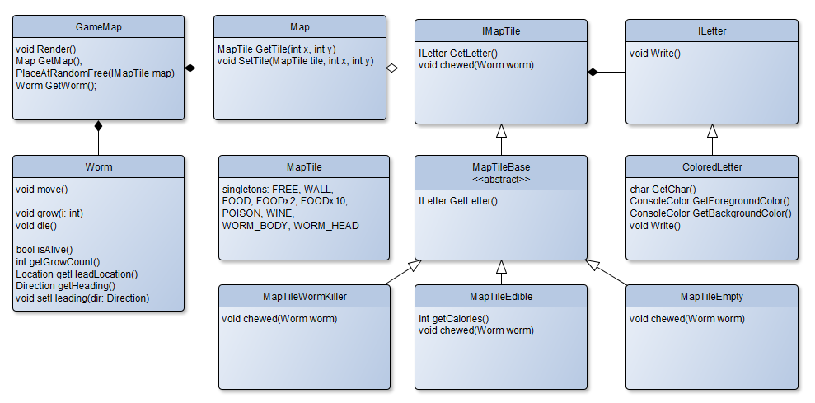
Assignment 4 Representing the Game Model + View

Slide 6
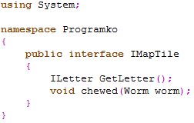
Assignment 4 Representing the Game Model + View
We’re going to have “generic” tile described by “letter” and “what happens when the Snake chews the tile”.

Slide 7
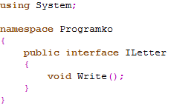
Assignment 4 Representing the Game Model + View
And the “letter” will in-fact be anything that can “output” some character to a screen. Again, we’re trying to embrace “procedural knowledge” here rather then “symbolic” one.

Slide 8
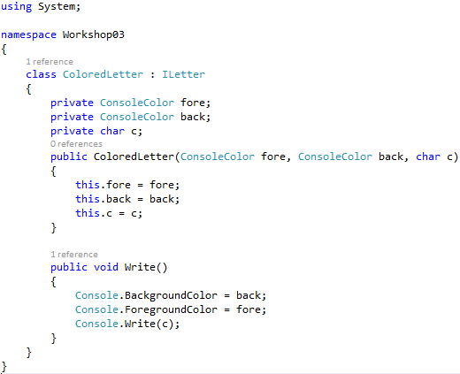
Assignment 4 Representing the Game Model + View
And thus we can have an implementation that outputs some character in chosen colors. The trick is, that the “ILetter” is oblivious to what “IMapTile” does … thus you can pair “visual style of the tile” with “its implementation of chewed()” as you see fit!

Slide 9
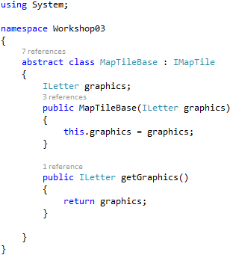
Assignment 4 Representing the Game Model + View
So, let’s define our “abstract” base for all tiles… you know, every tile will need to specify it’s ILetter … composition over inheritance here!

Slide 10
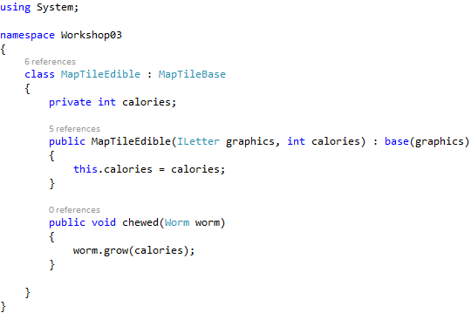
Assignment 4 Representing the Game Model + View
Now the real deal… MapTileEdible … here we specify “what” should happen when “the Snake chewes” the tile.
Note that apart from “grow” we should place a new food into the map as well!

Slide 11
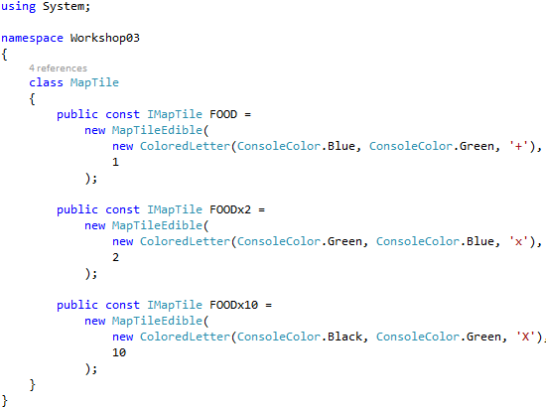
Assignment 4 Representing the Game Model + View
Thus, we can easily define any type of food we can ever dream of … almost.

Slide 12
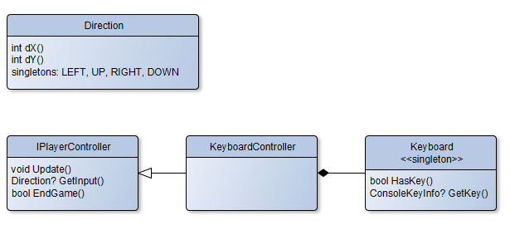
Assignment 4 Getting Player’s Input

Slide 13
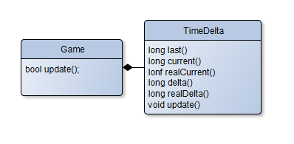
Assignment 3 Game & Time

Slide 14
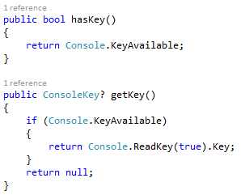
CheatSheet Reading Inputs from Keyboard

Slide 15
CheatSheet Timing your Snake

Slide 16
CheatSheet Changing Console Output Color
Google: C# Console Position / Colors / Random
Google – The Best Programmer’s Friend
Keep in mind the limit of “Googling” for “Code”
It’s always OK to Google for “API”
It’s okay to do the research “how to approach some problem”
It’s always bad to act as script kiddies who just copy-paste others’ code without understanding

Slide 17
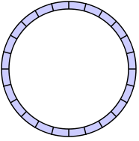
CheatSheet Implementing the Snake’s body
Circular array / buffer
Array
Holding „start“ and „end“ index
Which can overflow…

Slide 18
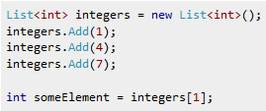
CheatSheet Implementing the Snake’s body
Or just use „List“ – array that can change its size automatically

Slide 19
Assignment 4 Send me an email
Email: jakub.gemrot@gmail.com
Subject: Programming II – 2016 – Assignment 04
Zip up the whole project and send it
You WILL NOT find the assignment in CoDex!
Deadline: 4.4.2016 23:59

Slide 20
Questions? I sense a soul in search of answers…
In case of doubts about the assignment or some other problems don’t hesitate to contact me!
Jakub Gemrot
jakub.gemrot@gmail.com

