Slide 1
Programming II
Faculty of Mathematics and Physics
Charles University in Prague
3rd March 2016
C# Made Easy!
Workshop 2 – Gentle C# + OOP Introduction

Slide 2
Workshop 2 Outline
Test
C#, OOP, UML
Homework

Slide 3
Test 02 Quick Warm up!
Find the test here (no-ads):
https://goo.gl/qO9uhA
Permanent link:
https://docs.google.com/forms/d/1it-GI5EdCcQNzDyhNkJdk-Ehx0iGSMdgVc_dGQVMGXM/viewform
Time for the test:
10 min

Slide 4
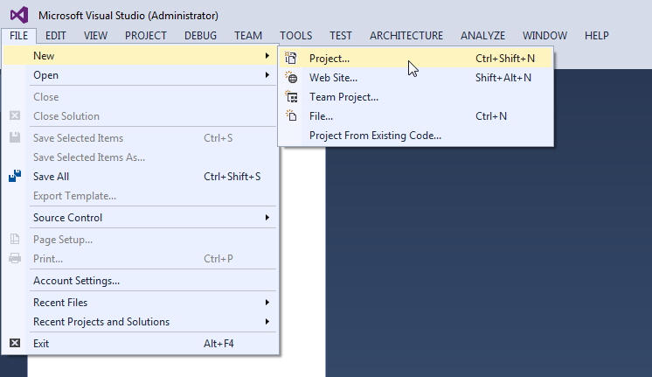
C# Visual Studio 2015
1. Creating new Solution and Project

Slide 5
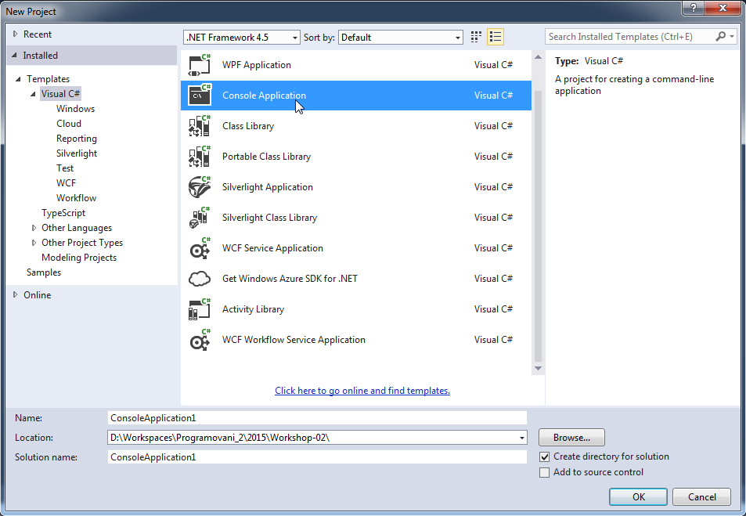
C# Visual Studio 2015
1. Creating new Solution and Project

Slide 6
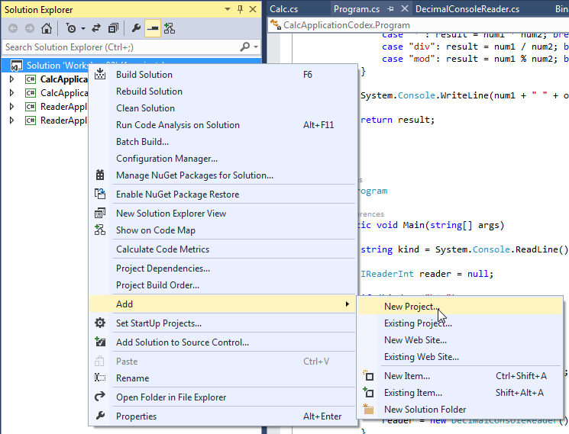
C# Visual Studio 2015
2. Adding new Project into an existing Solution

Slide 7
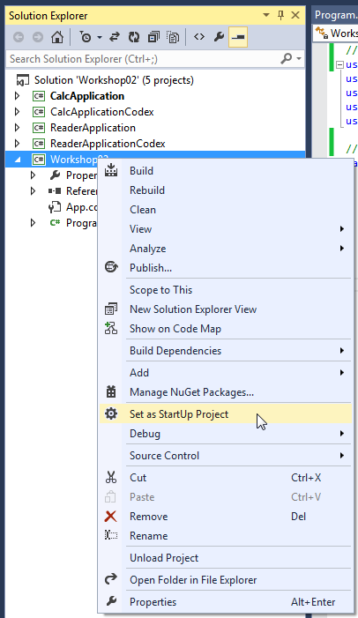
C# Visual Studio 2015
3. Changing “main” project

Slide 8
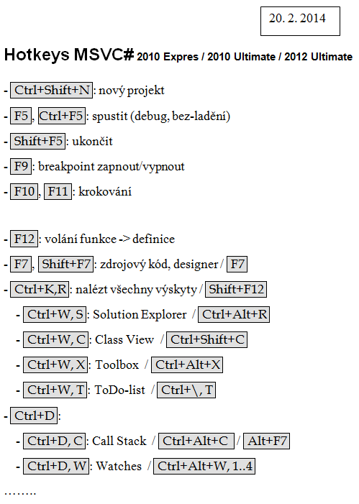
C# Visual Studio 2015
4. Hot-keys overview

Slide 9
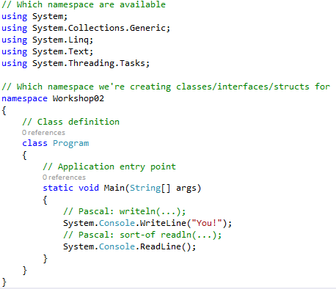
C# Basics
Code wrapped within classes, which are wrapped within namespaces.
Specific method as application “entry point”, which is invoked as the first by .NET

Slide 10
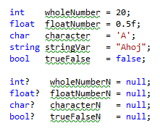
C# Declaring variables
“Standard” types and their nullable counterparts.
Why is there no “string?” … ?
string is already a class!

Slide 11
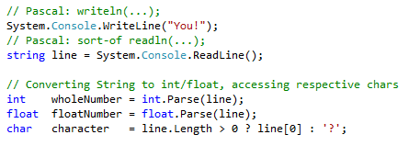
C# Reading/Writing from/to console
Sort of writeln() but different readln()…

Slide 12
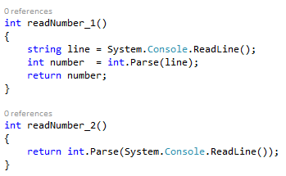
C# Functions
<return type> <function name>(<parameters>) {
<function body>
return <value of return type>;
}

Slide 13
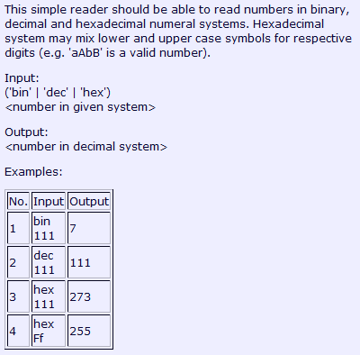
C# Task 2.1.1
Create a simple number reader
Use functions only

Slide 14
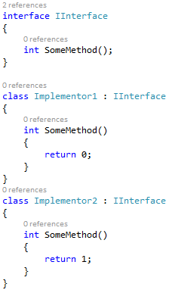
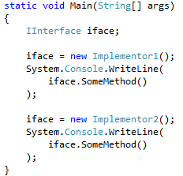
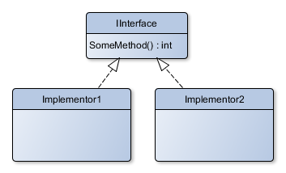
C# Interfaces, Classes
Hiding concrete implementation behind common interface.
UML

Slide 15
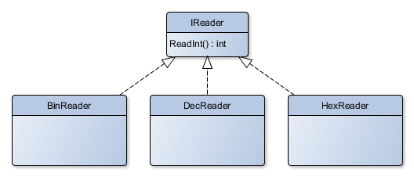
C# Task 2.1.2
Create common IReader interface
Provide different implementations

Slide 16
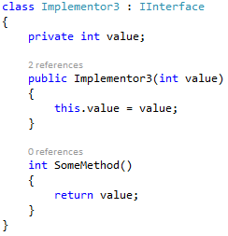
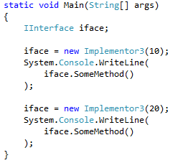
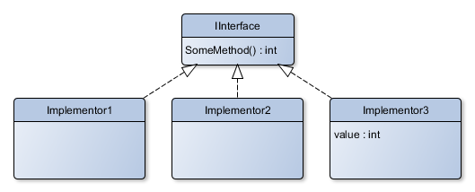
C# Constructor
Enforcing correct initialization of the object.
UML

Slide 17
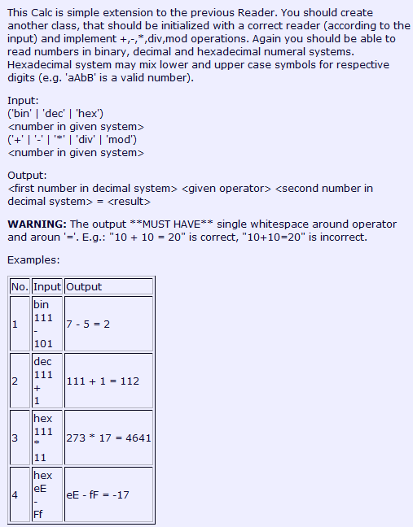
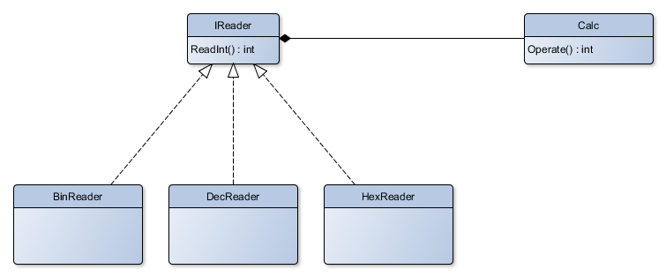
C# Task 2.2
Create Calc class that will internally use some IReader
UML - Composition

Slide 18
Assignment 2 Send me an email if you haven’t already
If you have not sent me an email during Assignment 1, DO IT NOW!
Email: gemrot@gamedev.cuni.cz
Subject: Programming II – 2015 – Assignment 02
Content:
Your name
Your CUNI number
Your CoDex nick
I will add you into a CodEx group

Slide 19
Assignment 2 Code tasks 2.1, 2.2
Create implementations for tasks 2.1, 2.2 (if you haven’t already) and submit them to CodEx; each task worths 5 points
Deadline: 9.3.2015 23:59

Slide 20
Questions? I sense a soul in search of answers…
Sadly, I do not own the patent for perfection (and will never do)
In case of doubts about the assignment or some other problems don’t hesitate to contact me!
Jakub Gemrot
gemrot@gamedev.cuni.cz

