Slide 1
Programming II
Faculty of Mathematics and Physics
Charles University in Prague
20th April 2015
C# Made Easy!
Workshop 09 – GDI+

Slide 2
Workshop 09 Outline
Test
Fun with Graphics!
Homework

Slide 3
Test 09 Test
Find the test here (no-ads):
http://goo.gl/fdJVgZ
Permanent link:
https://docs.google.com/forms/d/1rzaYggXx9hEuLjAPvHBS7fudw1hqGhwaKrqVaUed23w/viewform
Time for the test:
15 min

Slide 4
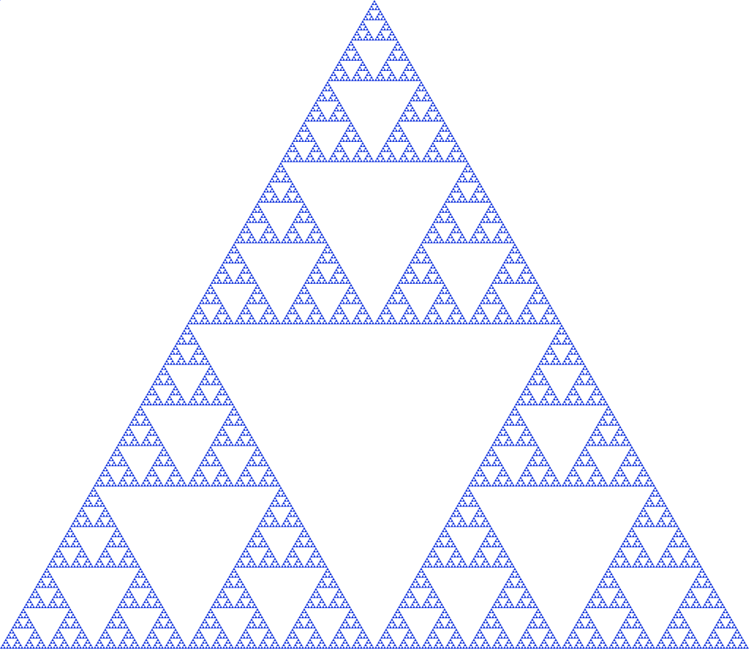
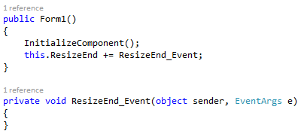
Task 09.1 (or Homework) Sierpinsky Triangle
Let’s draw this beast!
Good to know
Form.ClientSize
Determining drawable area
Using (g = this.CreateGraphics()) {}
Form.ResizeEnd event
Polygon drawing
Google:
Draw Filled Triangle C#
http://stackoverflow.com/questions/21684873/c-sharp-fill-polygon-triangle
Notes:
Delete this slide …

Slide 5
Task 09.1 (or Homework) Sierpinsky Triangle
Redraw on screen resize (full width + height)
Provide edit box that allows to set the “recursion step”
Watch out for exceptions! [You shall not fail!]
https://msdn.microsoft.com/en-us/library/b3h1hf19%28v=vs.110%29.aspx
Provide color picker box to select the triangle color
Google: ColorDialog
5 points
Deadline: 26.4.2015 23:59
Notes:
Delete this slide …

Slide 6
Task 09.2 (or Homework) Get ready…
Have you played this during last week?
This is going to be huge ☺

Slide 7
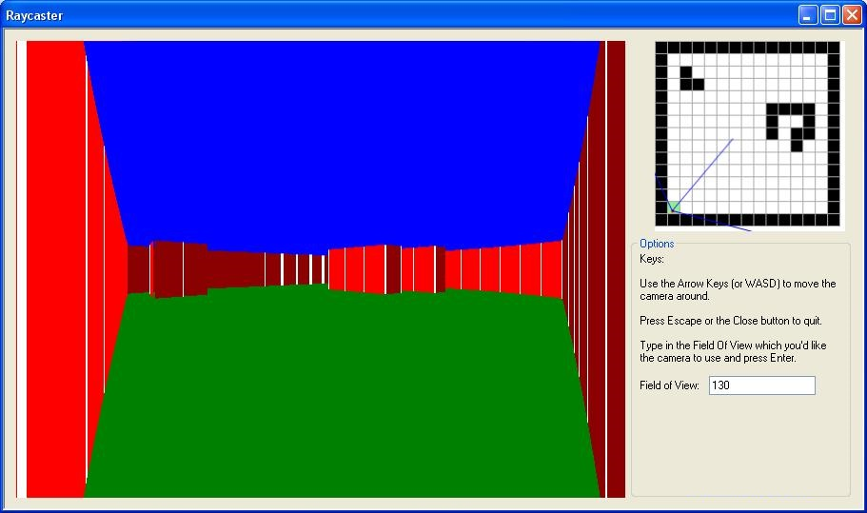
Task 09.2 (or Homework) 3D Engine!
Have you played this during last week?

Slide 8
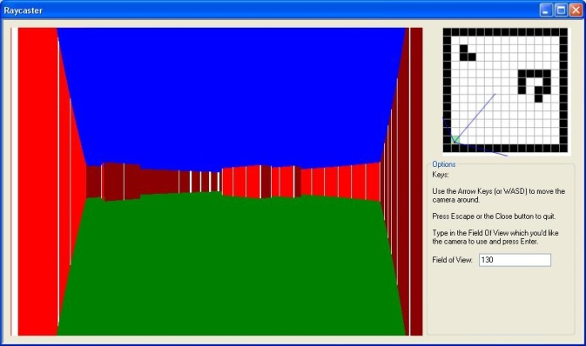
Task 09.2 (or Homework) 3D Engine!
Have you played this during last week?
Don’t get scared!
Can be written in about 300 lines!
http://goo.gl/QbcSt0
Permalink:
http://www.playfuljs.com/a-first-person-engine-in-265-lines/
Input file:
NxN
<maze>
Example
10x6
##########
#........#
####.###.#
#..#.#.#.#
#........#
##########
20+5 bonus points

Slide 9
Task 09.2 (or Homework) 3D Engine!
On Event (button clicked / resize):
//DrawSky() // optional
//DrawFloor() // optional
DrawWalls()
Drawing walls will need
double Raycast(x, y, angle, max)
[x;y] where we’re casting the ray from
angle (horizontal) we’re throwing the ray in
max – limiting raycasting length
Returns distance to the wall or (-1) if the wall not hit in “maxDistance”
Can be done by various algorithms
Notes:
Delete this slide …

Slide 10
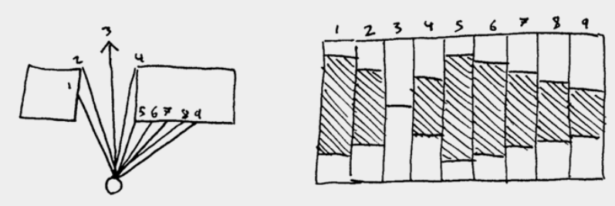
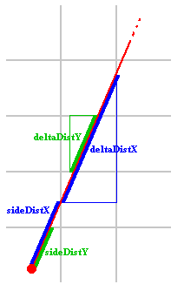
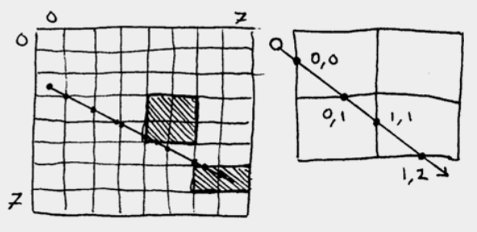
Task 09.2 (or Homework) 3D Engine!
http://lodev.org/cgtutor/raycasting.html
Notes:
Delete this slide …

Slide 11
Task 09.2 (or Homework) 3D Engine
Different colors for different wall sides
Redraw on screen resize
Provide buttons for Movement (turn left/right, move forward/backward)
Provide color picker for walls
Provide a way for changing FOV
Provide a way for disabling “fish-eye” correction
30 points
Bonus section
Provide movement through keyboard (WSAD)
5 bonus points
Do not cross walls
5 bonus points
Draw sky + floor + provide color pickers for them
5 bonus points
Deadline: 10.5.2015 23:59
Notes:
Delete this slide …

Slide 12
Assignment 09.1 / 09.2 Send me an email
Email: jakub.gemrot@gmail.com
Subject: Programming II – 2015 – Assignment 09.1/09.2
Zip up the whole project and send it
You WILL NOT find the assignment in CoDex!
Deadline:
09.1: 26.4.2015 23:59
09.2: 10.5.2015 23:59

Slide 13
Questions? I sense a soul in search of answers…
Sadly, I do not own the patent for perfection (and will never do)
In case of doubts about the assignment or some other problems don’t hesitate to contact me!
Jakub Gemrot
gemrot@gamedev.cuni.cz

