Slide 1
Programming II
Faculty of Mathematics and Physics
Charles University in Prague
13th April 2015
C# Made Easy!
Workshop 08 – Dynamic Programming

Slide 2
Workshop 08 Outline
Test
Dynamic Programming

Slide 3
Test 08 Almost no-test
Find the test here (no-ads):
http://goo.gl/PNdTKc
Permanent link:
https://docs.google.com/forms/d/1Iy7Baqo3gYj-Lhm1NBADHAVDQohs2yiCbaQvbiJyuM0/viewform
Time for the test:
10 min

Slide 4
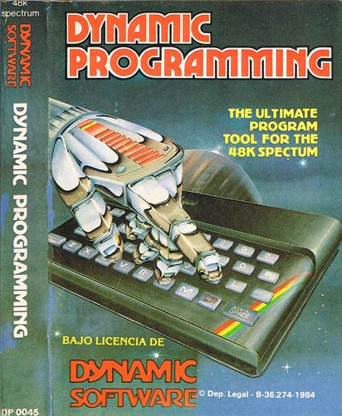
Topic Dynamic Programming
Have you played this during last week?

Slide 5
Task 01 Keys
We have a key that is determined by 5 “teeth”
Every tooth can be in 5 positions
Difference in positions between 2 teeth can be -1, 0, 1
How many types of such key you can have?
Notes:
Delete this slide …

Slide 6
Task 02 Tank Rental
You run a successful TANK RENTAL bussiness
Literally, you have only 1 TANK
You have a lot of bookings.
But you cannot fulfill all of them …
… you have to maximize your profit
You have list of (future) bookings
Rent: Start day + time
Back: End day + time
Money
How to determine which set of bookings to accept?
Notes:
Delete this slide …

Slide 7
Task 03 From the life of MFF boy/girl
You’re really lucky MFF boy/girl ...
… as you have a boy/girlfriend!
The problem is that, lately, you have to walk around the city a lot.
And not every street is really interesting…
What’s worse, your partner’s street-taste is opposite of yours!
But you have boy/girlfriend still, so that’s not a problem!
To make it bearable both of you have decided to take turns in choosing streets ...
Notes:
Delete this slide …

Slide 8
Task 03 From the life of MFF boy/girl
Fortunately enough, the city you live in has NY-style streets (perpendicular) and blocks (squares), so the choices are really limited.
And you are always walking between [A;B] -> [C;D] via ‘shortest path’.
Is there a way for you to maximize your or his/her payoff (according where do you want to get…) during the walk?
Notes:
Delete this slide …

Slide 9
Task 04 The problem of the Egg and the Skyscraper
WOW! Gene industry has outperform itself! They pull of hens that produce really eggs with really hard shells!
Now its up to you to determine “how much hard” is the hard…
You have “N” eggs and a really tall skyscraper … how many attempts do you need to determine the number of the floor, the egg breaks when thrown from?
Notes:
Delete this slide …

Slide 10
No Assignment Still time to finish the Hospital!
Email: jakub.gemrot@gmail.com
Subject: Programming II – 2015 – Assignment 07
Zip up the whole project and send it
You WILL NOT find the assignment in CoDex!
Deadline: 19.4.2015 23:59

Slide 11
Questions? I sense a soul in search of answers…
Sadly, I do not own the patent for perfection (and will never do)
In case of doubts about the assignment or some other problems don’t hesitate to contact me!
Jakub Gemrot
gemrot@gamedev.cuni.cz

