Slide 1
Programming II
Faculty of Mathematics and Physics
Charles University in Prague
6th March 2015
C# Made Easy!
Workshop 3 – Unleashing the Snake

Slide 2
Workshop 3 Outline
Practice Terms
Test
The Snake (as homework)

Slide 3
Test 03 Quick Warm up!
Find the test here (no-ads):
http://goo.gl/bp7mto
Permanent link:
https://docs.google.com/forms/d/1N1vM3UNe-sD8S2tbRxf2df5pRfy9cV6TGA7y0DVqi5c/viewform
Time for the test:
10 min

Slide 4
Revisiting the Homework What is the benefit of having interfaces?
Discussing “Simple Calc” example.
Console application (text-based game)
Snake is controlled either by WSAD, or arrows, or 8246 numbers
Escape key terminates the game
Provide solution that can easily change
Map dimensions
Ask me on how big map I want to play (max 80 x 40)
Food effects
Adding new should be as easy as creating and „registering“ a new Food object
Implement POISON
That kills the snake
Implement WINE
That reverse the controls

Slide 5
Assignment 3 Create “The Snake” aka “The Worm” game
Console application (text-based game)
Snake is controlled either by WSAD, or arrows, or 8246 numbers
You have to display “snake’s length” and “time elapsed” somewhere at “bottom status line”
Escape key terminates the game
Implement tiles: Empty, Wall, Food, Posion, Wine, “Snake”
Snake movement speed should be increasing every N food eaten (regardless their calories)
Provide solution that can easily change
Map dimensions
Ask me on how big map I want to play (max 80 x 40)
Food effects
Adding new food should be as easy as creating and „registering“ a new Food object
Both POISON and WALL kill the snake
Implement WINE so it reverse the controls (UP<->DOWN, LEFT<->RIGHT)
Points:
10, if finished till 15.3.2015, 23:59
5, if finished later on
Bonus:
Provide different visualization for the snake’s body using
<, v, >, ^ as a head … -, | as a straight body and / \ at “turning points”
3 points

Slide 6
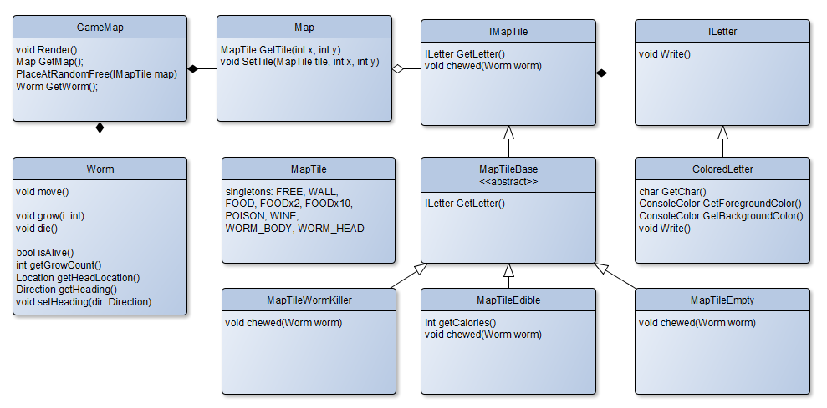
Assignment 3 Representing the Game Model + View

Slide 7
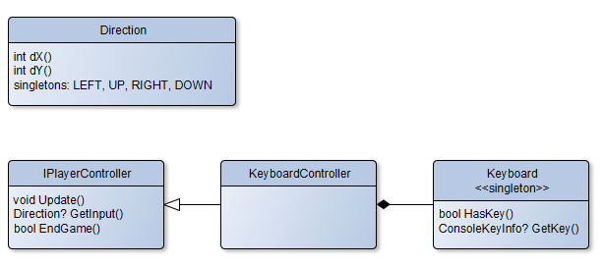
Assignment 3 Getting Player’s Input

Slide 8
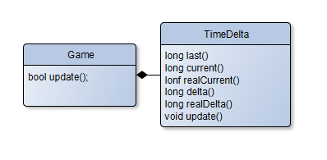
Assignment 3 Timing the Game

Slide 9
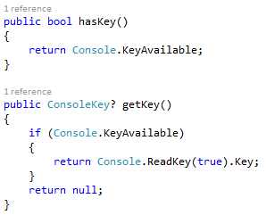
CheatSheet Reading Inputs from Keyboard

Slide 10
CheatSheet Changing Console Output Color
Google: C# Console Colors
Google – The Best Programmer’s Friend
Keep in mind the limit of “Googling” for “Code”

Slide 11
CheatSheet Timing your Snake

Slide 12
Assignment 3 Send me an email
Email: jakub.gemrot@gmail.com
Subject: Programming II – 2015 – Assignment 03
Zip up the whole project and send it
You WILL NOT find the assignment in CoDex!
Deadline: 15.3.2015 23:59

Slide 13
Questions? I sense a soul in search of answers…
Sadly, I do not own the patent for perfection (and will never do)
In case of doubts about the assignment or some other problems don’t hesitate to contact me!
Jakub Gemrot
jakub.gemrot@gmail.com

